Slide 1
Data Gathering
PASS
Lab Assignment

Slide 2
Instructions
Make a copy of this document and fill it with your responses.
For each question, use the space on the slide to show your response, and/or add additional slides as needed. Highlight your responses where possible so that we can see them easily
Place the completed document into your Lab Assignments folder and include a link to it in when you submit. Place your code into an appropriately named directory within your git repository.
Submit using the lab assignment submission form which can be found on the class website.

Slide 3
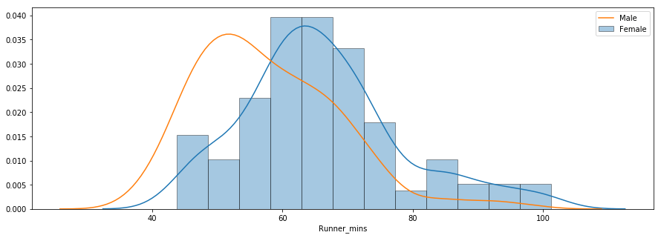
1. Beautiful Soup Activity
Do the Steps listed in this document: Beautiful Soup Lab Activity
Were you successful? Did your code produce a graph like this one at the end?
Yes Code produces Graph like this at end.

Slide 4
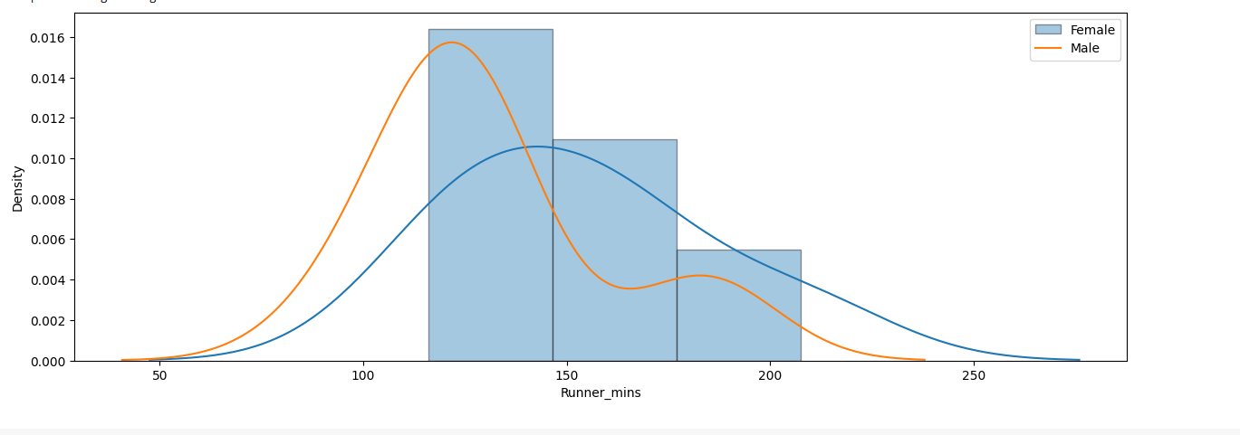
2. Is Your Code Robust?
Always strive to develop robust code that works in multiple situations and does not need to be adjusted for each new set of input data. Of course, we generally achieve robustness through testing. So test your code with a new/different road race: https://www.hubertiming.com/results/2023WyEasterLong
A. Does your code succeed with this data as well?
B. For this new race, provide a screenshot of a graph similar to the one shown in the previous slide of this lab assignment.
This looks good
A.Yes Code Succeded with data only some column names need to be renamed.
B.

Slide 5
3. REST API Activity
Do the Steps listed in this document: REST API Activity
Enter DONE here when finished:
DONE

Slide 6
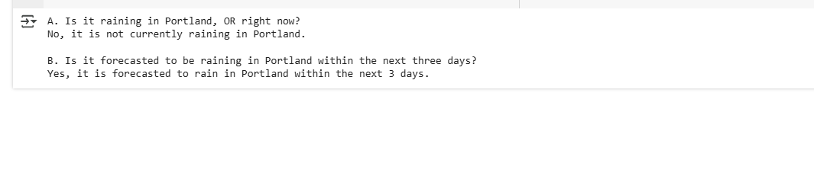
4. Apply your knowledge
Develop a simple Python program that accesses the OpenWeatherMap API and answers these two questions:
A. Is it raining in Portland, OR right now?
B. Is it forecasted to be raining in Portland within the next three days?
Show the output of your program here:

Slide 7
5. Provide your code
Save your code (for both the BeautifulSoup activity and the REST activity) within a folder called “DataGathering” (or a similar name) within your git repository.
Provide a URL link to your git repository:
https://github.com/jbtuku/Data-Gathering/tree/main

